Slide 1


Project -1
Student Test Scores
Presenters: Tanner Blattner, Long Le, Cindy Reynoso, Brandon Nicholson

Slide 2


Hypothesis
Null Hypothesis: A favorable student environment has no effect on academic performance.
Alternative Hypothesis: A favorable student environment positively affects academic performance.

Slide 3
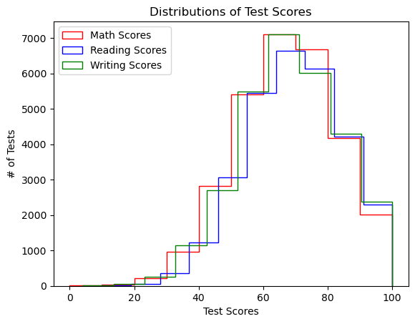
Disclaimers
Dataset is entirely fictional but also not random
Null values were filled with averages of the data OR they were randomly assigned based on unique values.
Notes:
The dataset is fictional but is not random. It is simulated based on real-life collective data from multiple sources.
We also treat the null data with average values or random values based on unique categories. The test scores are factored based on different categories.

Slide 4
Definitions of a favorable environment (from more to less)
Parent Education: Master’s -> Bachelor’s -> Associate’s -> Some College -> High School -> Some High School
Parent Marital Status: Married -> Single -> Divorced -> Widowed
Practice Sport: Regularly -> Sometimes -> Never
Lunch Type: Standard -> Free/Reduced
Test Prep: Completed -> Not Completed
Transportation: Private -> School Bus
Weekly Study Hours: > 10 -> 5-10 -> <5
Number of Siblings: 1 -> 2 -> 3 -> …
* Favorability is not based on fact but rather upon consensus of our group.

Slide 5
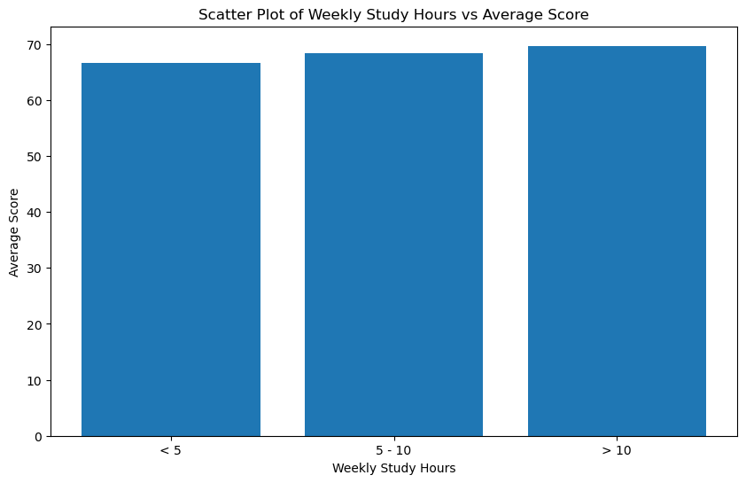
Weekly study hours affects students average score
Students that studies 10 hrs or more weekly are more likely to have a passing score.
This students are also more likely to have the highest average scores.
There are students that study less than 10 hrs. that have passing scores/ high average scores, but it's more likely for a student to perform better when they study for 10 hrs.

Slide 6
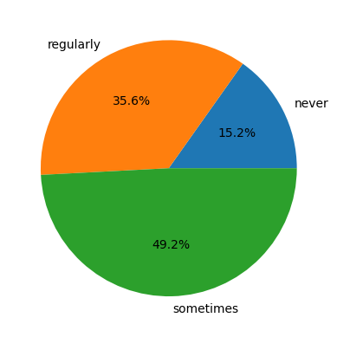
Studying 10 hrs. and playing sports
The Pie Chart shows only students that studies 10 hrs or more weekly.
More than half of this students play sports.
35.6% of students play regularly and 49.2% plays sometimes. The last 15.2% don’t play sports.
In conclusion playing sports have a positive effect on students performance.

Slide 7
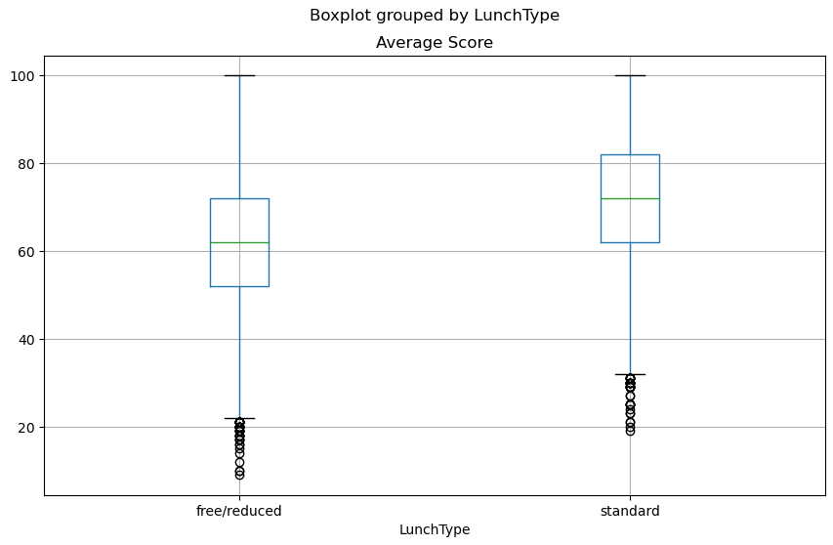
How does lunch quality affect student academic performance?

Slide 8
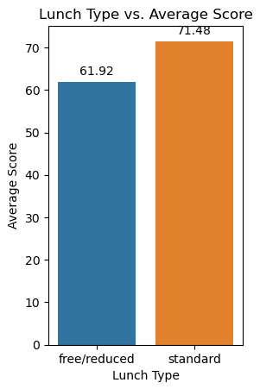
How does lunch quality affect student academic performance?
Lunch quality is an interesting determinant to students’ average score.
Free/reduced lunch vs. standard lunch.
Average score of 61.92 vs. 71.48: a grade different
p-value is 0.00, so it is statistically significant. I can 100% confidently say that lunch quality and average score are correlated.

Slide 9

How does lunch quality affect student academic performance?
Why does lunch type correlate to average score?
Students’ concentration/health.
A study in 2017 has shown that healthier school lunches are correlated to test score.
It is due to nutritional quality of the meals would affect the students’ concentration in classes.
Students’ background.
Students having free/reduced lunch tends to come from economically difficult families.
They do not have as good academic environment as others.
Anderson, M., Gallagher, J., & Ritchie, E. R. (2017). School Lunch Quality and Academic Performance. https://doi.org/10.3386/w23218

Slide 10
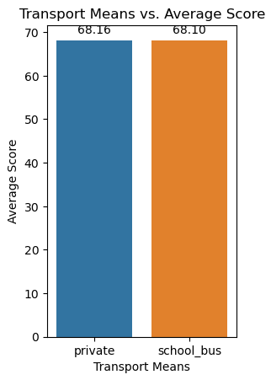
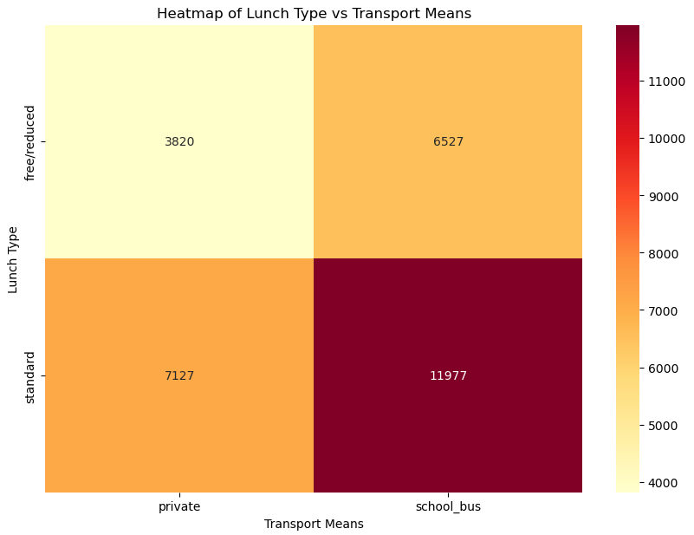
But students’ background only has a minimal impact…
p-value is 0.74.
Almost no difference between students coming to school by private transportation and by school bus.
Notes:
relation -

Slide 11
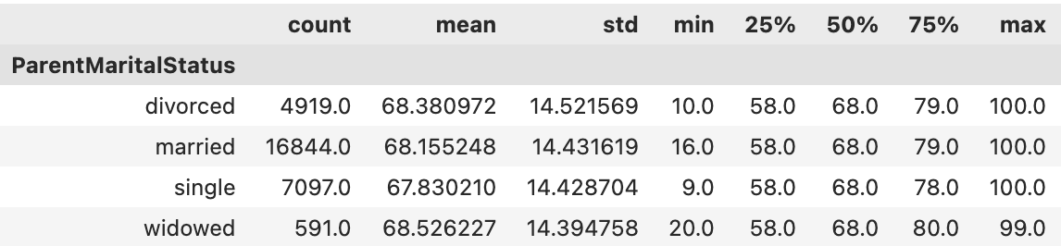
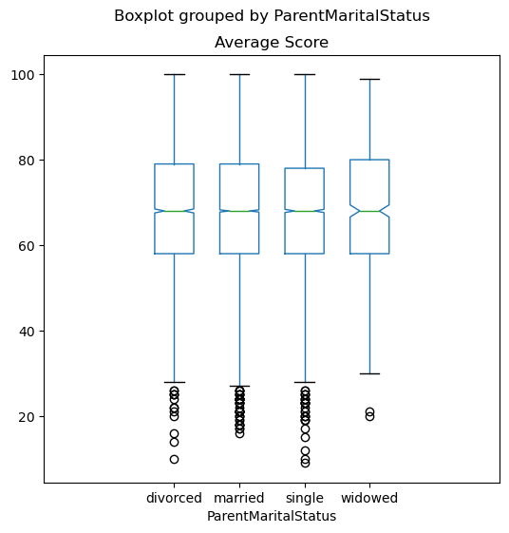
Student - Parent Marital Status Relation to Test Scores
Majority of students have married Parents. Minority of students have a widowed parent.
How did the tests compare across groups?
Means varied at most by .7%
Medians were identical
IQRs were virtually identical
ANOVA test revealed a P Value of .169…

Slide 12
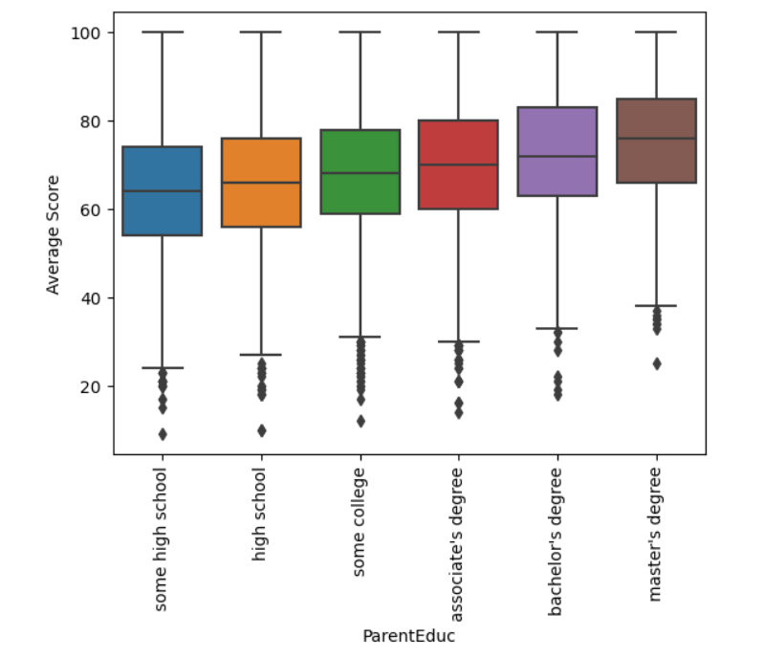
How Does Parent Education Affect Test Scores?
The visualizations and statistical analysis prove that test scores improve as parent education level increases.
P-Value is 1.45e-197
(basically zero)

Slide 13
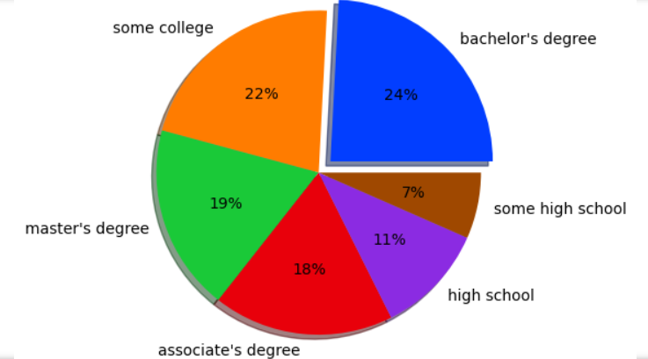
How Does Parent Education Affect Test Scores?
A bachelor’s degree is the most common education for the students’ parents, making up 24% of the data.
Parents are more likely to have a master’s degree than only high school and some high school combined.

Slide 14
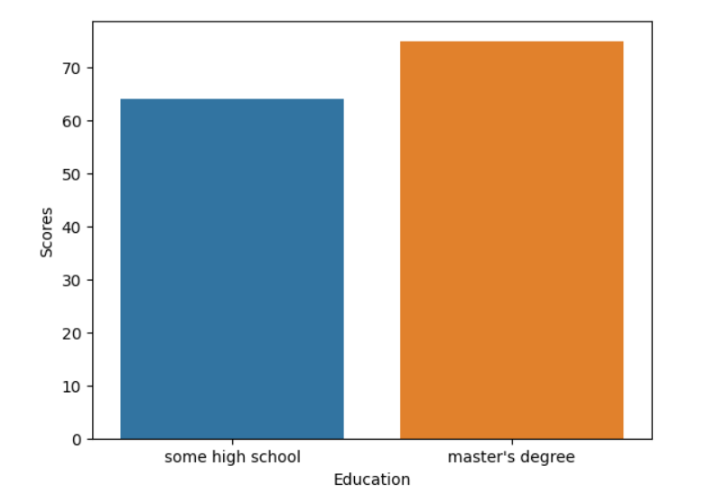
How Does Parent Education Affect Test Scores?
The average test score for students whose parents only have some high school is 63.8% while the average for those with a master’s degree is 74.8%.
The difference is 11%.

Slide 15
Conclusion
Null Hypothesis: A favorable student environment has no effect on academic performance.
Alternative Hypothesis: A favorable student environment positively affects academic performance.
From our analysis, we can confidently say that students’ nutrition and parents’ education background are the most impactful factors to academic results.

Slide 16
Questions?

